Slide 1
ADO Boards Migrating from Jira

Slide 2
Jira vs ADO Boards
Why Switch?
Investment in ADO
One System for Issue Tracking and Source code / better integration
Better support for Scaled Agile
Jira
Initiatives → Epics → Story (Dev Ticket)
ADO
Epics → Features → User Story (Dev Ticket)
ADO names the work items in line with the “real world” concepts

Slide 3
Jira -> ADO Migration
Solidify Basics and Benefits
Uses Jira and ADO APIs to export and import respectively
Automatically preserves Attachments
Translates Jira types to ADO work items (e.g., Initiative to Epic)
Simple mapping of most fields
Preserves Links (parent/child)
Drawbacks
Some links were not recreated. I believe that Clone links in Jira were not handled well and could even have messed up other kinds of links
Needed to manually reconcile
Alternatives
Export Jira to Excel – massage data – import to ADO – update and verify ADO work items
Bifurcate: Leave old and in-progress issues in Jira and create new work items in ADO

Slide 4
Jira -> ADO Migration: Solidify Preparation
Overall Directions in Solidify’s Blog
https://solidify.dev/blog/jira-azure-devops-migration
Before getting started, come up with a plan to divide and conquer
Avoid importing what you don’t need
Do you need to import Closed Jira artifacts?
Divide your Jira exports to manageable chunks (e.g., < 1000)
Need a Jira query for each subset
Divide by Component and/or Type
"query": "Project = ETFS AND cf[14933] = 'Mt. Sharp' AND status not in (Rejected) AND component in ('ETF Basket Management’) AND type in (Initiative, Epic)“
Create Export Directories that mirror the divisions (except for types…)
Set up ADO Boards with new fields you might need
Jira Link (more of an ID, than a Link)
Get the latest Solidy tool
Unchanged since last August (2020):
https://github.com/solidify/jira-azuredevops-migrator/releases

Slide 5
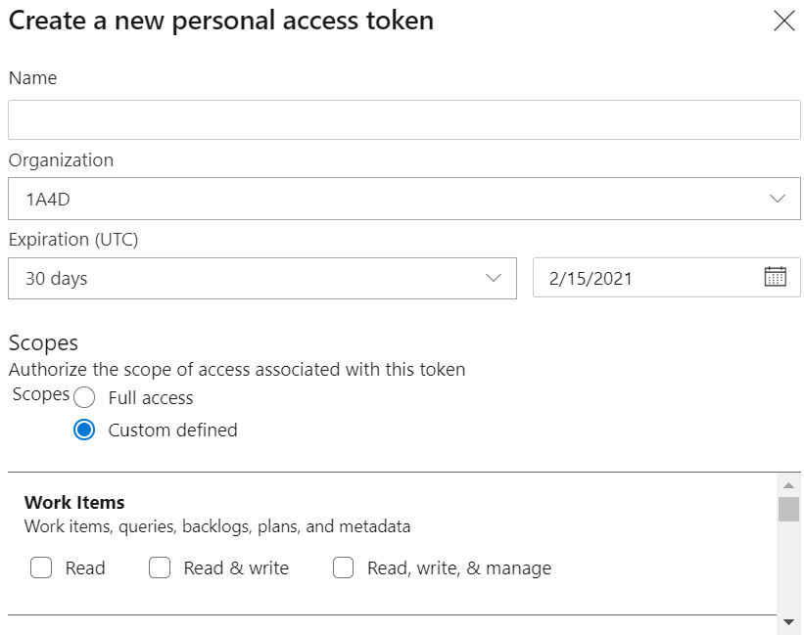
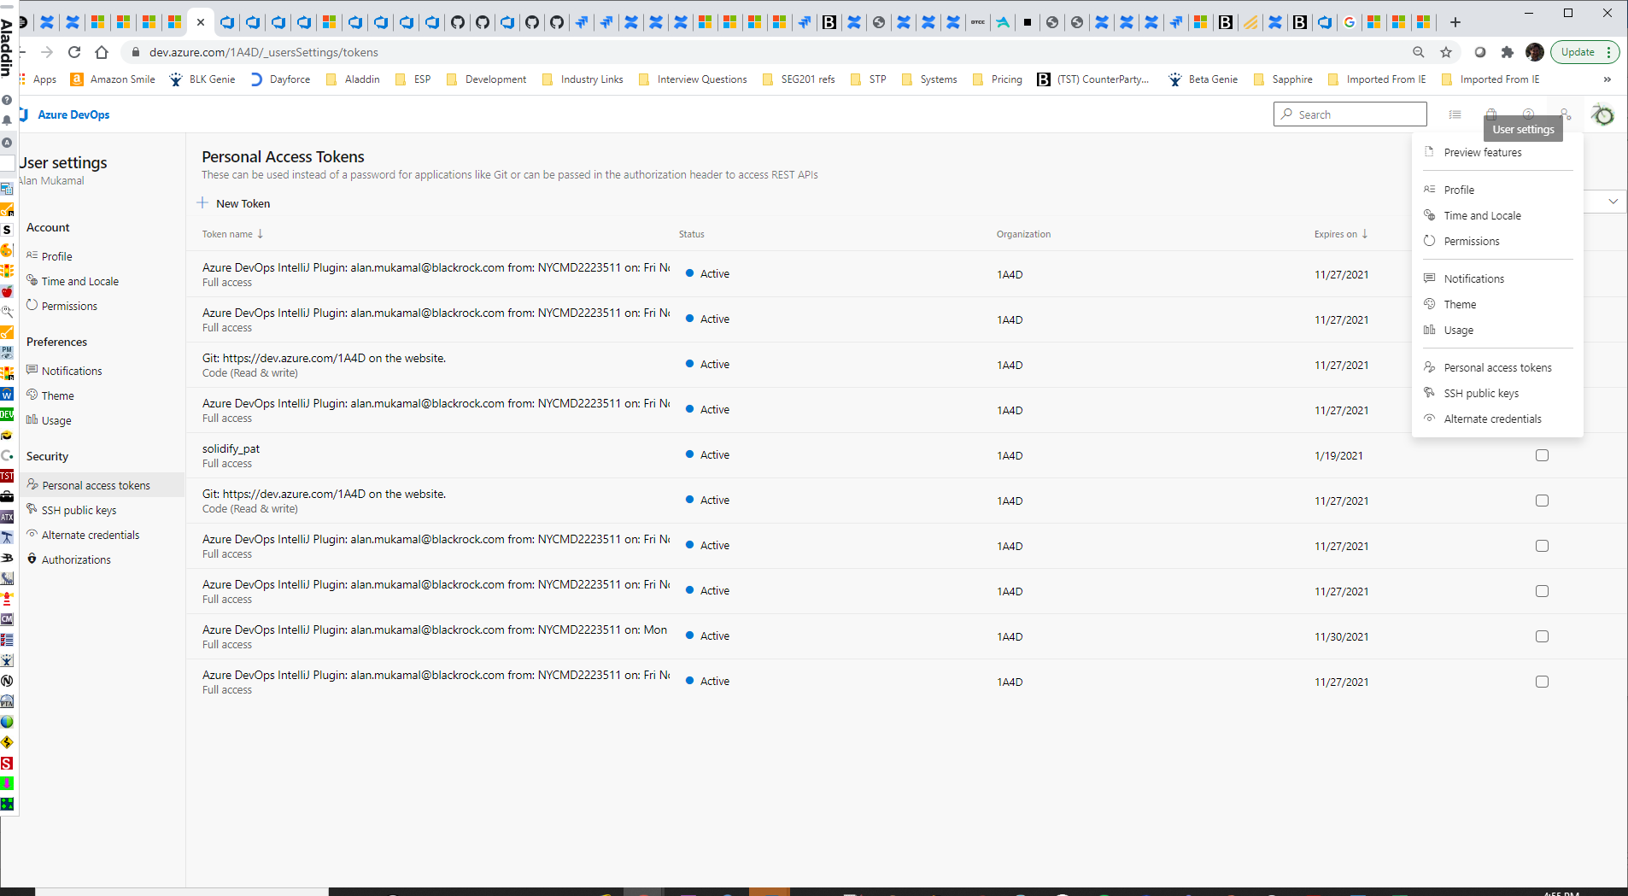
Create a Personal Access Token (PAT)
s

Slide 6
Jira -> ADO Migration: Solidify Configuration
Documentation on Configurations:
https://github.com/solidify/jira-azuredevops-migrator/blob/master/docs/config.md
Work Item Mapping Example
"type-map": {
"type": [
{
"source": "Initiative",
"target": "Epic"
},
{
"source": "Epic",
"target": "Feature"
},
{
"source": "Story",
"target": "User Story"
},
…
] }
Field Mapping Example
"field-map": {
"field": [
…
{
"source": "key",
"target": "Custom.JiraLink",
},
…
]
}

Slide 7
Jira -> ADO Migration: Solidify Export from Jira
Export Command
.\jira-export.exe -u amukamal –p xxxx --url https://webster.bfm.com/jira --config .\config-esp_test1.json –force
xxxx = your BLK password (for Jira)
I did two exports per component into the same directory to handle a Linking problem.
I used a separate workspace directory per component
Initiatives and Epics
"query": "Project = ETFS AND cf[14933] = 'Mt. Sharp' AND status not in (Rejected) AND component in ('ETF Basket Management’) AND type in (Initiative, Epic)",
"workspace": "C:\\Projects\\ADO_Migration\\esp_BM",
"epic-link-field": "Parent Link",
Stories, Enhancements, Bugs, Tasks, etc.
"query": "Project = ETFS AND cf[14933] = 'Mt. Sharp' AND status not in (Rejected) AND component in ('ETF Basket Management’) AND type in (Story,Enhancement,Bug,Task,'Non-Dev Task',Sub-task)",
"workspace": "C:\\Projects\\ADO_Migration\\esp_BM",
"epic-link-field": “Epic Link",

Slide 8
Jira -> ADO Migration: Solidify Import to ADO
Import Command
.\wi-import.exe --token cuzpiwgzdbj2qg################mn67vvym7gs4prcqistuya --url https://dev.azure.com/1A4D --config .\config-esp_test1.json --force
token is the ADO PAT
After each Jira Component Export (Epics/Initiatives & Stories/Bugs) to the same directory, I imported all artifacts for that Component.
This preserved most of the links from Initiative to Epic as well as Epic to Story
Some Trial & Error: Test & Validate
Since I was able to control the export query, I was able to do multiple practice exports and imports. If I found a field was not mapping correctly, I revised the configuration file and deleted the imported work items in ADO and retried till I was satisfied with the results.

Slide 9
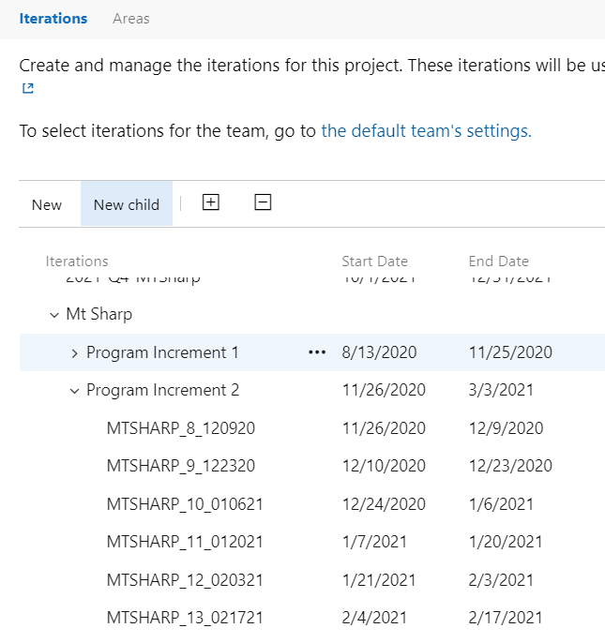
Area Paths, Iteration Paths and Users
Area Paths
"base-area-path": "Basket Management",
In Jira, the component was used to identify the Business Segment, so that was naturally what we put in the ADO Area Path.
Iteration Paths
"base-iteration-path": "Mt Sharp",
This base path was prepended to the Sprint.
After the import, I used the Iteration configuration for each team to insert the Program Increment between the overall initiative (Mt Sharp) and the Sprint
Users
Fortunately, users are based on our emails / user ids and they are the same in Jira and ADO, so no additional mapping file was needed.

Slide 10
Appendix
Solidify’s Blog & Github
https://solidify.dev/blog/jira-azure-devops-migration
https://github.com/solidify
Config readme in Github: https://github.com/solidify/jira-azuredevops-migrator/blob/master/docs/config.md
Scaled Agile Framework
https://www.scaledagileframework.com/
Quick reference index for Azure Boards settings
https://docs.microsoft.com/en-us/azure/devops/reference/quick-reference-index-boards-settings?view=azure-devops

